Slide 1


Unveiling the Divide: A Tale of Two Economies
Female Labor Force Participation: India vs. Germany
A Statistical Journey Through Two Economic Landscapes
India FLFPR ~30.3%, Germany ~51.3% (2022 est.)
Presented By:
Aakash Vashist (100004661)
Abhishek Negi (100004670)
Garima Agarwal (100004523)

Slide 2


Table Of Contents
Introduction
Statistical Measures
Line Plot Comparison
Distribution Graph
Yearly By Change %
Q-Q Plot For Normality
CLT (Sample Means) - India
CLT (Sample Means) - Germany
Final Mean Comparison After T- Test
Conclusion
Resources

Slide 3
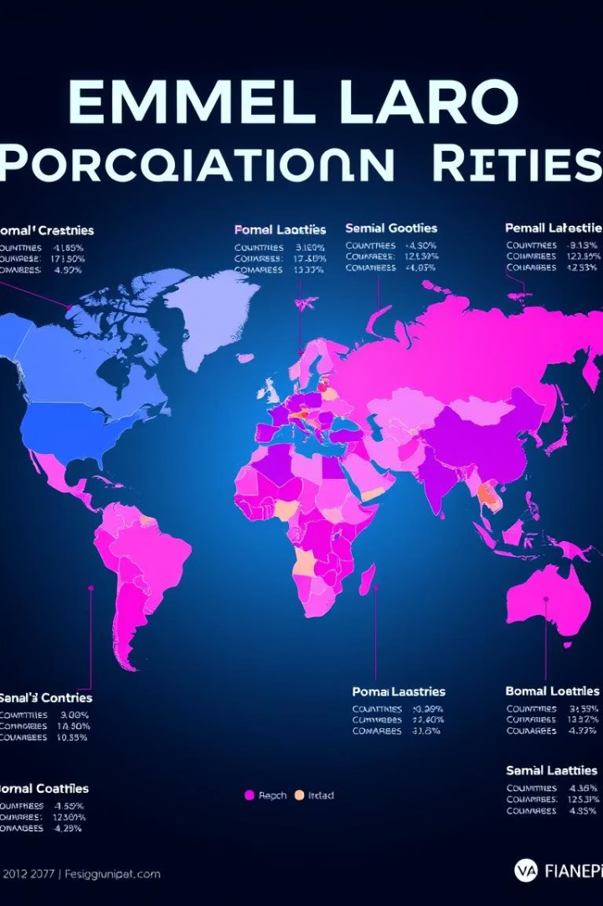
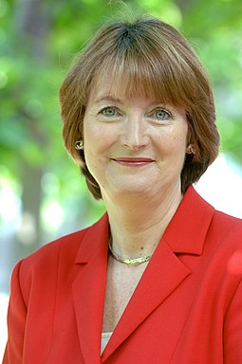



Setting the Stage: Introducing FLFPR
What is FLFPR?
Why It Matters
Percentage of women employed or actively seeking work.
Key economic indicator of gender equality and workforce potential.
Global Trends
FLFPR varies due to culture, economy, and policy differences worldwide.

Slide 4
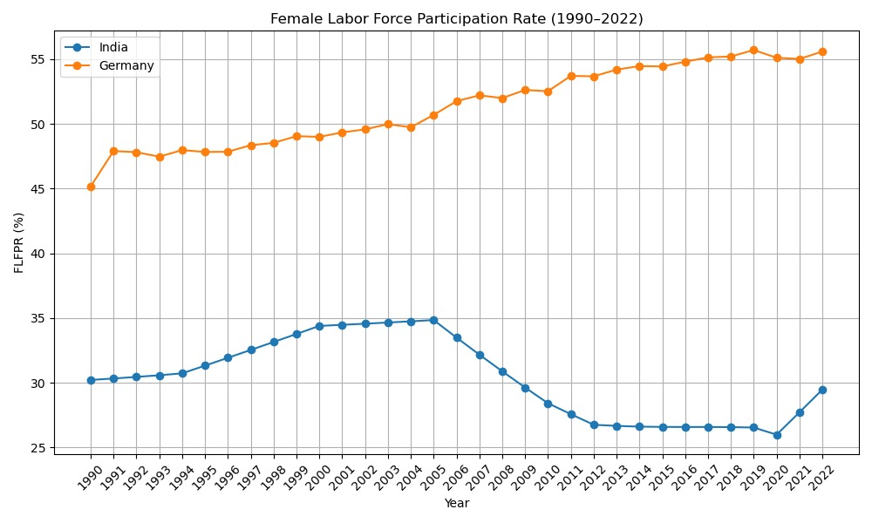
Painting the Picture: Line Plot Comparison
Interpretation:
Germany's FLFPR shows a consistent upward trend, increasing from around 45% in 1990 to over 55% in 2022, indicating progressive inclusion of women in the workforce.
India's FLFPR rose slightly from about 30% in 1990 to a peak near 35% in the early 2000s, but then saw a steady decline until around 2020, before a slight recovery by 2022.
Overall comparison highlights a widening gap between the two countries, with Germany maintaining significantly higher and improving female labor participation, whereas India's rate remained lower and showed a long-term decline.
Fig 1.

Slide 5
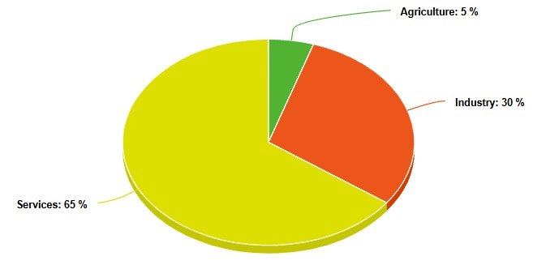
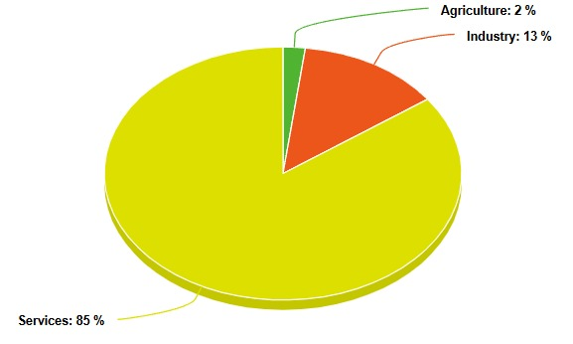
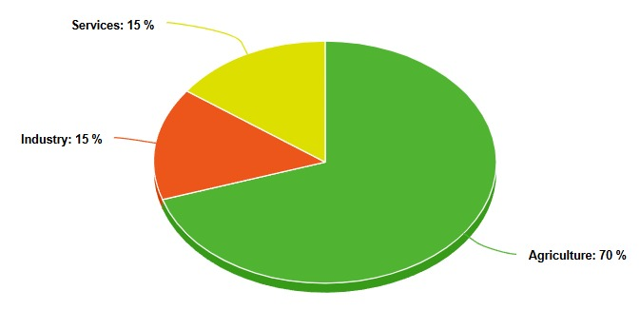
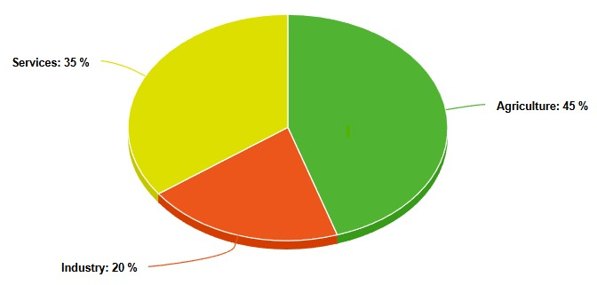
Pie Chart Comparison
Germany: 1990
Germany: 2022
India: 1990
India: 2022
Fig 2.

Slide 6
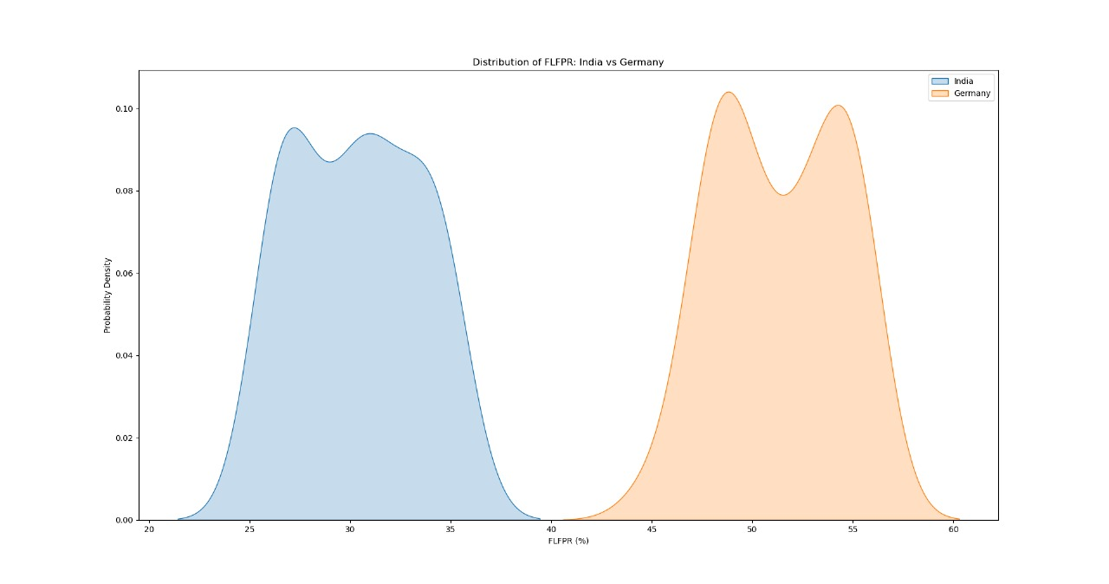
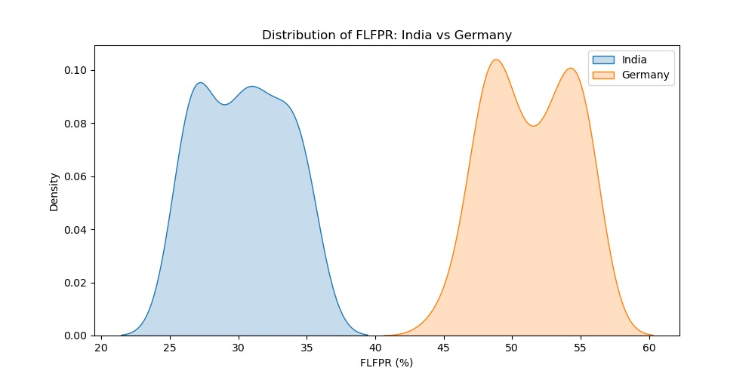
Distribution Of FLFPR: India Vs Germany
Fig 3.

Slide 7
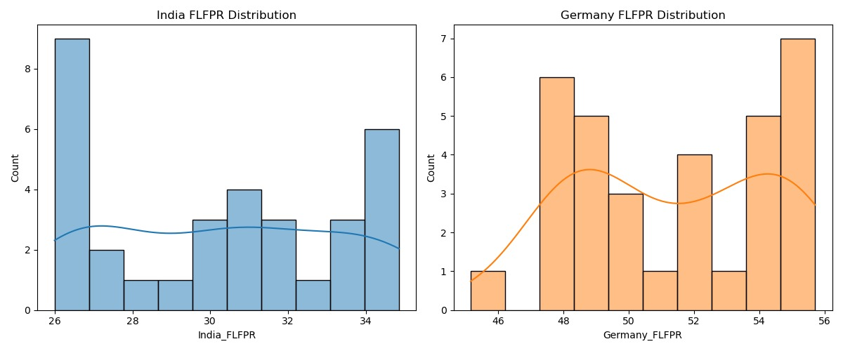

Histogram Comparison
Fig 4.

Slide 8
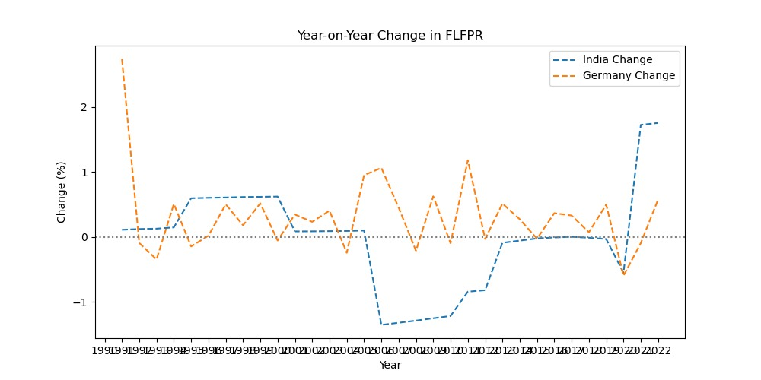
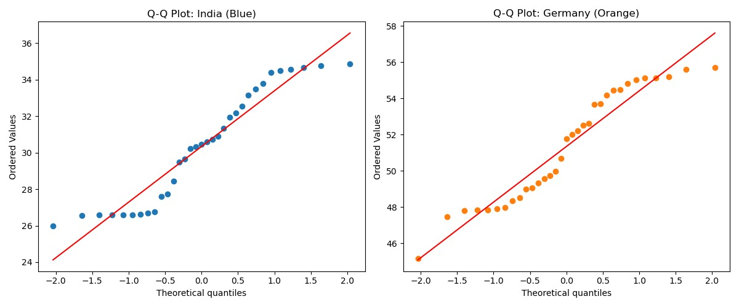
Q-Q Plot For Normality
Fig 5.

Slide 9
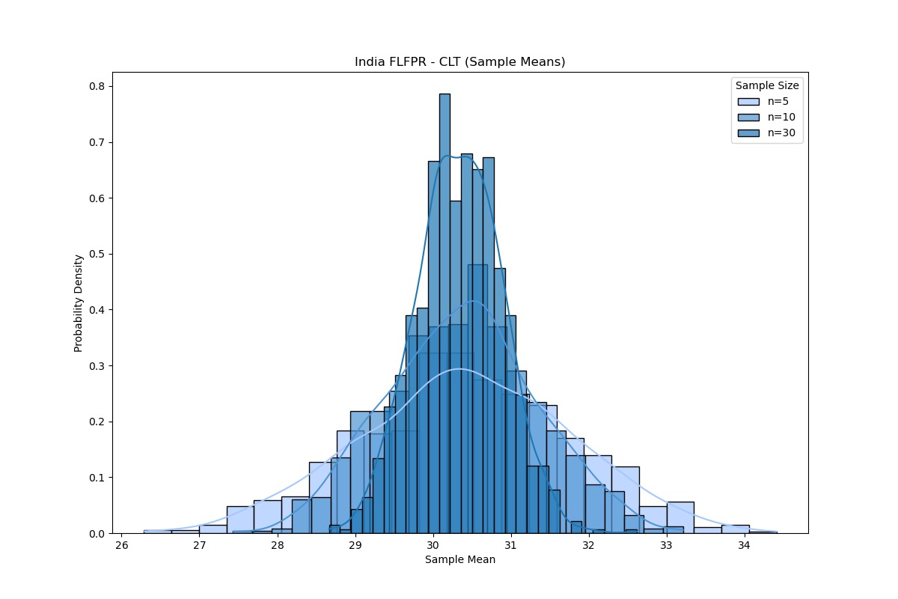
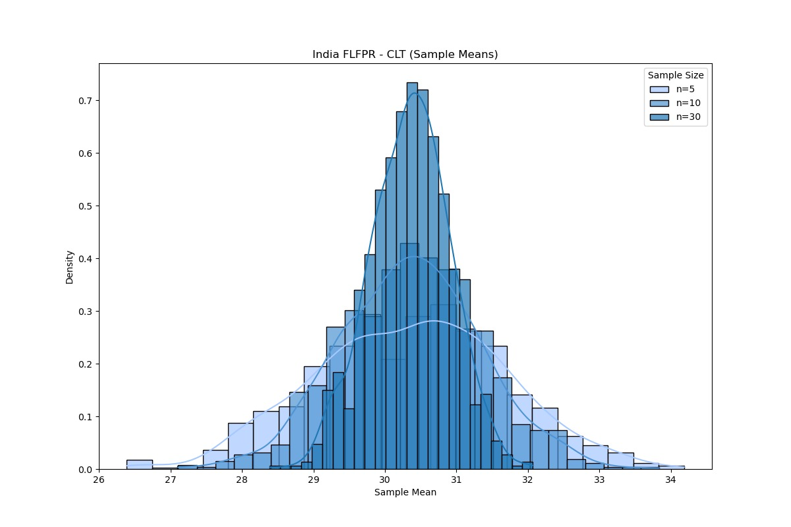
CLT (Sample Means) - India
Fig 6.

Slide 10
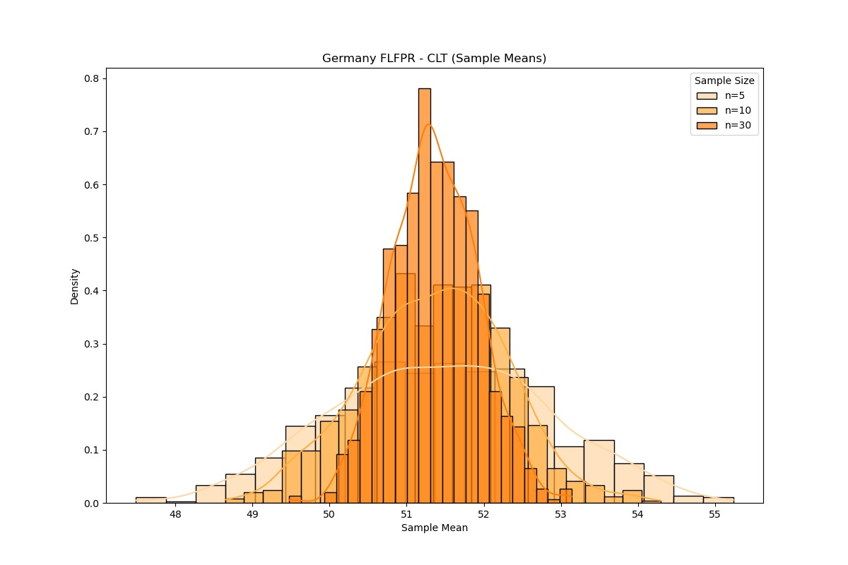
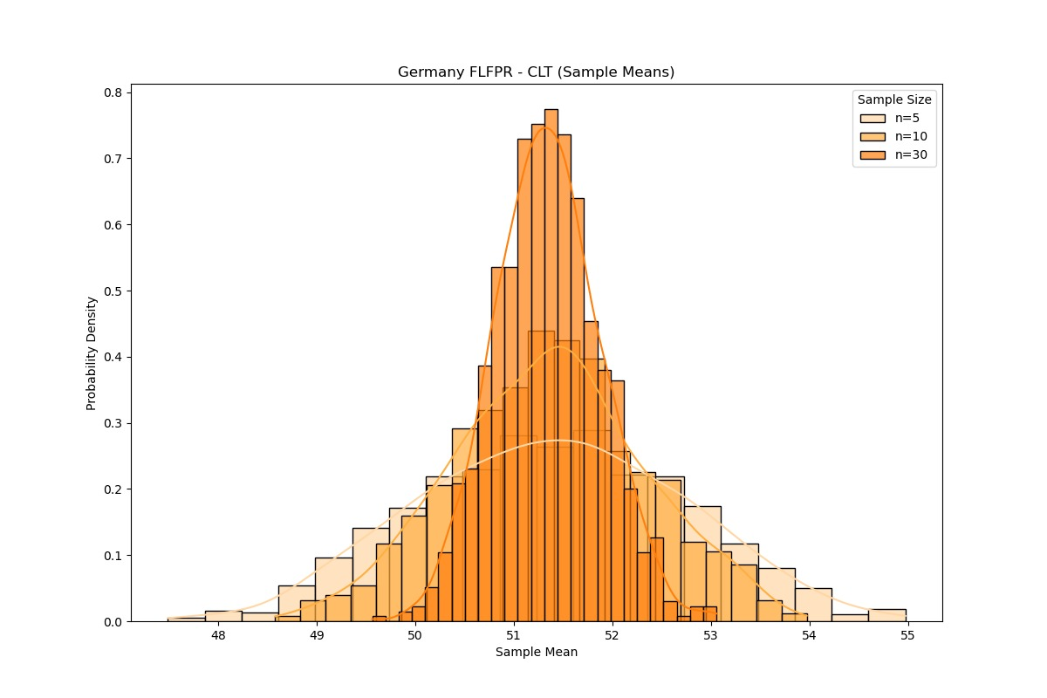
CLT (Sample Means) - Germany
Fig 7.

Slide 11



Data Summary of the Countries
Sample Means (FFLPR)
Sample Means (FFLPR)
India (Sample size n = 30)
Germany (Sample size n = 30)
Shapiro p-value: 0.1827 (Normal)
Shapiro p-value: 0.0936 (Normal)
Hypothesis Tests (Final Values) :
Levene’s Test (equal variances): p = 0.7300
Welch’s t-test (unequal variances) p = 0.0000
Mann-Whitney U test (non-parametric) p = 0.0000

Slide 12
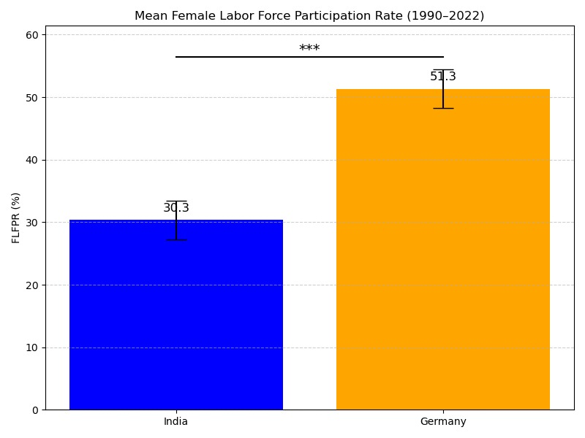
Final Mean Comparison
Fig 8.

Slide 13




Conclusion: Bridging the Gap
Key insights highlight stark FLFPR differences and growth potential.
Gender equality drives economic empowerment and social progress.
Collaborative efforts can close the participation gap globally.

Slide 14

Sources
World Bank Open Data: https://data.worldbank.org/ Shapiro, S. S., and Wilk, M. B. (1965). An Analysis of Variance Test for Normality. Central Limit Theorem. (Various sources in theoretical statistics).
Germany – 2022 (World Bank data via Trading Economics):Trading Economics. (2024). Germany - Employment in services, female (% of female employment). https://tradingeconomics.com/germany/employees-services-female-percent-of-female-employment-wb-data.html
India – 2022 (PLFS data):India Briefing. (2023, January 30). More women engaged in manufacturing activities in India: Report. https://www.india-briefing.com/news/more-women-engaged-in-manufacturing-activities-in-india-report-33936.html
Historical estimates for India and Germany – 1990:IMann-Whitney U test (non-parametric) International Labor Organization. (n.d.). ILOSTAT Database. https://ilostat.ilo.org/(Note: 1990 data are approximated based on trends from the ILO and various academic estimates.)
All the plots, graphs and code: 53-97. (n.d.). Tools & Methods: Data Analysis [GitHub repository].

Slide 15




Connect With Us!
Aakash Vashist
Abhishek Negi
Garima Agarwal

Slide 16


